Slide 1
SwarSync - The AI Powered Music Collaboration Platform
MAY 2024

Slide 2
Teams Members
Anushka Banerjee
Soham Das
FRONTEND
DATA VISUALIZATION
Branch : B.Tech CSE
Year : 3rd
Branch : B.Tech CSE
Year : 2nd
Ankit Biswas
BACKEND AND INTEGRATION
Branch : B.Tech CSE
Year : 3rd
Abhishek Basak
Kaustubh Upadhyay
FRONTEND
AI ANALYSIS
Branch : B.Tech CSE
Year : 3rd
Branch : B.Tech CSE
Year : 2nd

Slide 3
Table of contents
IDEA BRIEF
PROCESS FLOW
HIGHLIGHTS
APPENDIX
Teams
Vision
Goals
Use Case Diagram
Product Roadmap
Technology Stack
Unique Features
Load time optimization
Risks and challenges
Next steps

Slide 4
Idea Brief
SwarSync is a web-based platform designed to facilitate collaborative music creation and sharing. It integrates AI-driven tools for chord and note
recognition, lyrics generation, language classification, and multilingual
support. Users can register, create profiles, and collaborate on song projects in real-time, utilizing chat functionalities and global collaboration invitations.

Slide 5
VISION
To become the go-to platform for musicians worldwide, fostering creativity, collaboration, and discovery through advanced AI-driven tools and seamless communication features.

Slide 6
Goals
Provide a user-friendly interface for musicians of all skill levels.
Enable seamless collaboration and communication among users.
Offer accurate AI-driven tools for enhancing music composition.
Create a vibrant community of musicians sharing and discovering new music.

Slide 7
Process Flow
This process flow outlines the key stages involved in the SwarSync project, from user registration and collaboration to AI-driven analysis and song publishing. It highlights the platform's focus on enabling collaboration, enhancing creativity, and fostering a vibrant community of musicians.

Slide 8
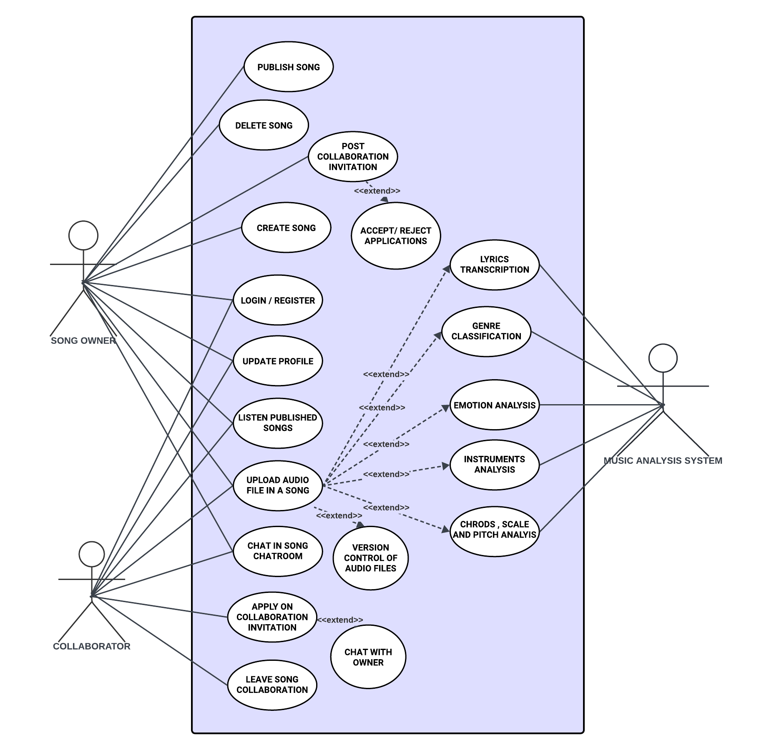
Use Case
AI-driven chord and note recognition
Lyrics generation and translation
Language classification
Multilingual support for music files
Seamless chat functionalities within song dashboards
Global collaboration invitations
Music Generation on user prompts

Slide 9
COFIDENTIAL
Feature highlights
Explore these unique features and to unleash musical potential with SwarSync. Join our community of passionate musicians and embark on a journey of creativity, collaboration, and discovery.

Slide 10
Unique Features
PROTOTYPE
AI-Driven Composition: Experience the power of artificial intelligence in music creation. Our platform utilizes cutting-edge AI algorithms to analyze, interpret, and generate original musical compositions , revolutionizing the way music is made.
Chord and Note Recognition: Unlock the secrets of your compositions with advanced chord and note recognition capabilities. Our system analyzes uploaded music files to identify chords and notes, providing invaluable insights for refining your creations.
Lyrics Generation: Say goodbye to writer's block with our AI-powered lyrics generation tool. Seamlessly generate captivating lyrics based on your musical inspiration, whether it's a catchy melody or an emotional chord progression.
Language Classification: Break down language barriers with our language classification feature. Ensure accurate processing and analysis of multilingual music files, catering to a global community of musicians and artists.
Multilingual Support: Embrace diversity and inclusivity with
multilingual support for music files. Our platform
accommodates various languages, allowing users from
different cultural backgrounds to express themselves freely.

Slide 11
Unique Features
PROTOTYPE
Generate Music from Prompt: Ignite your creativity with our innovative "Generate Music from Prompt" feature. Simply provide a prompt or brief description, and watch as our AI crafts original musical compositions tailored to your specifications.
Seamless Collaboration Workspace: Collaborate effortlessly with our intuitive workspace. Upload, edit, and version-control audio files in real-time, facilitating teamwork and enhancing the collaborative process.
Global Collaboration Invitations: Connect with like-minded musicians from around the world. Post collaboration invitations globally, allowing interested users to apply and participate in your projects, fostering a vibrant and diverse community.
Chat Functionalities: Foster communication and exchange ideas with dedicated chat rooms within song dashboards. Discuss concepts, provide feedback, and coordinate efforts with collaborators in real-time.
Secure and Scalable: Rest assured knowing your data and creations are safe with robust security measures. Our platform is designed for scalability, capable of handling large user bases and concurrent collaborations without compromising performance.

Slide 12
Optimizing the load in the system is crucial for ensuring smooth performance and seamless user experience, especially in a platform like SwarSync where users may upload, edit, and collaborate on multiple audio files simultaneously. Here are some strategies to optimize the load in the system:
Load Time Optimization
Distributed Architecture: Spread load across multiple servers or cloud instances to improve scalability.
Caching: Store frequently accessed data to reduce repetitive computations and improve response times.
Asynchronous Processing: Handle time-consuming tasks efficiently without blocking the main application thread.
Load Balancing: Distribute incoming traffic evenly across servers to prevent overloading.
Auto-scaling: Automatically adjust resource allocation based on demand to accommodate load fluctuations.
Optimized Data Storage: Minimize storage overhead and improve query performance through optimization techniques.
CDNs: Cache and deliver static content closer to end-users to reduce latency and improve download speeds.
Resource Consolidation: Identify and consolidate redundant resources to optimize utilization and reduce costs.
Implementing these strategies will ensure smooth performance and seamless user experience in SwarSync, even with multiple users collaborating on music projects simultaneously.

Slide 13
Product Roadmap
FOUNDATION
ENHANCED COLLABORATION
AI-DRIVEN ENHANCEMENTS
COMMUNITY BUILDING AND
OPTIMIZATION
MONETIZATION AND GROWTH
PLATFROM DEVELOPMENT
GLOBAL COLLABORATION INVITATIONS
MUSIC GENERATION FROM PROMPT
COMMUNITY MANAGEMENT TOOLS
MONETIZATION STRATEGIES
⚙️ Develop core infrastructure
🧪Create and apply to collaboration requests
🎛️Introduce the AI music generation feature
👥 Explore monetization strategies such as premium features, subscriptions, or partnerships with music industry stakeholders.
👥 Collaboration 1.0
and moderation tools
AI INTEGRATION
SEAMLESS COLLABORATION WORKSPACE
AI-DRIVEN ANALYSIS IMPROVEMENTS
OPTIMIZATION AND SCALABILITY
🗄️Integrate AI driven tools
📟 Add VCS features to Collab Space
📃 Enhance AI-driven tools for genre classification, emotion analysis, and instrument analysis.
⚙️ Conduct performance optimizations to ensure scalability and responsiveness of the platform.
USER ACQUISITION AND GROWTH
CHAT FUNCTIONALITIES
INTEGRATIONS
⚙️ Launch marketing campaigns for user engagement
👩‍👩‍👧‍👧 Interface for idea exchange
⛓️ Integrate Systems

Slide 14
Appendix
Some showstoppers to outline risks and challenges, also discussion on the next steps.

Slide 15
Risks and challenges
Scalability to handle large user base and concurrent collaborations
Security measures to protect user data and audio files
AI accuracy and reliability
Efficient collaboration management
Audio file compatibility and integration
Community moderation and management
In any system as complex as SwarSync, there are inherent risks that need to be carefully managed to ensure smooth operation and user satisfaction.

Slide 16
Next steps
Conduct user feedback sessions to gather insights for further improvements.
Launch marketing campaigns to attract new users and grow the user base.
Explore partnerships with music industry stakeholders for collaborative opportunities.
Expand platform functionalities based on user demand and industry trends.
Monitor and analyze platform metrics to measure success and identify areas for optimization.
Our plan to prevent the above risks and challenges can help us in further scaling of our system and enhancing the existing features for a better user experience.

Slide 17























Technology Stack
FRONTEND DEVELOPMENT
BACKEND DEVELOPMENT
DATABASE
CI/CD PIPELINE
HTML
JAVASCRIPT
TAILWIND
REACT
VITE
GitHub Actions
AI SYSTEMS:
VIDEO CONFERENCE
WEB SERVER
OPERATING SYSTEM
Hugging face
NGINX

Slide 18
Thank you

